Slide 1
Pattern learning, Pattern recognition
Sylvain Marié,
End User Business Group > Technology Strategy > Analytics for Solutions
V1.0 - 26/06/2013
V1.1 - 03/07/2013
With careful review and feedback from :
Rodolphe Héliot (Analytics for Solutions)

Slide 2

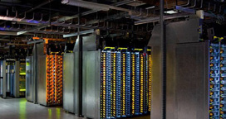
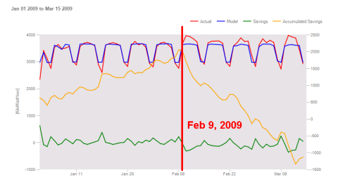
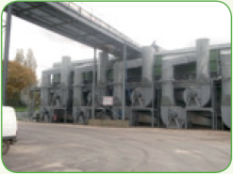
Problem examples
Patterns and correlations identification
Which environmental/process/other parameters actually impact the energy consumption of my facilities ?
Regression modeling
What is the caracteristic signature of this building? How to use this model to estimate performance savings ?
Forecasting
Will this datacenter consume at peak level tomorrow ? What’s the impact on the energy cost with respect to the tariff?
Virtual sensor
I need to measure humidity in my process’ output in real-time, but no sensor is available - only a manual measurement that takes a long time to perform.
Condition monitoring and diagnostics
Help me to detect when things go wrong that could harm the quality of my production / augment the cost / waste energy
Performance evaluation and benchmarking
Why did batch #3 take 20mins. longer / delivered poor quality products vs. Batch #8 ?
Notes:
Introduction: “Application-driven”: problem situation, application examples (from problem classes) for people to detect which problem(s) in their business this class of analytics could solve (up to 3 slides)

Slide 3
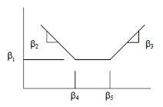
Example: regression modelling
E_{tot}
Create
Baseline Model
Apply Baseline Model
on post-retrofit conditions
When building is occupied
T_{ext}
Adjusted baseline energy
« if the retrofit had not taken place »
E_{tot,}
T_{ext}
Savings, or avoided energy use
Energy use
Actual measured energy
Baseline period
Retrofit
Assessment/reporting period
Very warm year !
Very cold year !
Time

Slide 4
What is pattern learning ?
Pattern learning = learn the relationship (pattern) between some data and a target data based on examples
Static relationship
Correlations
Dynamics
…
Notes:
Technology overview: general concepts, definitions. (up to 3 slides)

Slide 5




Problem generalization
We have example data about how our system works
Historical data, training data
We have a target = data that has a special importance to us
the data we want to predict,
the sensor data we want to replace by a virtual one,
the quality of the batch, that we want to better understand
…
We suspect that there is some pattern = some relationship between some of the data we have at hand, and the target.
But we don’t want to go deep with trying to get the true physical model, we rather get something approximated but fully automatic (black box)
We want to learn the pattern, because we are interested
in the pattern itself (correlations, regression analysis, benchmarking)
or in applying it again to generate useful data (forecasts, virtual sensor),
or in seeing if the system deviates from this pattern (condition monitoring and fault diagnosis)
(Baseline period)
(Building consumption E_{tot})
T_{ext}
O_{cc}
E_{tot}
T_{ext}
E_{tot}
O_{cc}
(reporting period)
Notes:
Technology overview: general concepts, definitions. (up to 3 slides)

Slide 6
How does it work ? « Offline learning »
(1) Select representative example data including the target variable
An initial set might be found by thinking about the system: « what might influence or be a tracer of my target variable ? »
Then don’t hesitate to add more data if available
provide enough examples so that it is representative (for time series data, a large-enough period of time. For controllable systems, excite them with step commands: this is called closed-loop or open-loop identification)
External constraints:
Weather conditions
Operating procedures…
Inputs/Supply,
Causes,
Outputs/Services,
Consequences
Internal characteristics:
Thermal insulation
Type of devices…
Internal variables:
State…
Training set
Training Perf = 91%
(2) Training :
The training set will be used to learn the « best » (*) model
As an output you will get the model and an estimate of its “goodness-of-fit”
The test set will be used to assess the model quality in an objective manner
As an output you will get an estimate of the expected accuracy (*) of the algorithm on new unseen data
Model
Test set
Test Perf = 76%
* several metrics exist for « best » and « accuracy » depending on the application

Slide 7
How does it work ? « Online learning »
(3) Now that the pattern has been learnt, apply it on new data
New data can be provided by batch, or example by example (streaming)
Applying the pattern will output an estimated value for the target variable
(4) Compare with the true value if available
if it is different, it is either a fault or an error of the algorithm. How to decide between the 2 ? Typically put an operator in the loop or use an additional diagnostics algorithm
Depending on the application we might want to learn the faults (for forecasting) or not (for FD).
Updating the model can be quick and approximative (true update) or slow and better (re-learning)
batch or stream
Apply model
New data
System
actual value (if available later)
prediction
Initial model learned offline
15
12
difference ?
FAULT DETECTED
AND/OR
Update model

Slide 8
Which use cases are supported?
Base data type
Boolean (« bi-nominal »)
Category (« poly-nominal »)
Date, time
Numeric (integer, real)
Complex object types
Images
Documents (text)
Web pages
Time series
Lab measurements: gene expression, …
Types of Targets
Classification: normal/abnormal, A/B/C…
Regression : numeric target
Types of patterns y=F(x₁,x₂,x_{3,}…,x_{n})
Linear: y = a₀+a₁x₁+a₂x₂+a₃x₃+…+a_{n}x_{n}
Piecewise-linear
Non-Linear
Static: the data is not temporal at all, -or - we just need to have a data snapshot at time t to estimate the target at time t.
Pseudo-Static: there is a way to express the problem as static (for example by lagging some data appropriately)
Dynamic: lags, inertia, n-th order integ./diff.…
Continuous: when input x changes of a very small amount, the target y changes of a very small amount
Discrete: there are “gaps” in the pattern
Physics-based:
Non physics-based: “data-driven”
Coming from systems or datasets with
one mode: without disruptive changes, stable
several modes, depending on « internal states » or internal/external conditions for transition
no modes at all: the pattern evolves with time as time goes

Slide 9

Different types of applications example with sensor data
01/01/2010 00:00
(Available historical records)
27/02/2013 19:30
(New records)
27/02/2013 20:30
Stream 1
…
…
(Data streams)
Target for forecasting
> Forecasting
Stream n
Target for virtual sensor
> Learning based virtual sensor
model
Learn the pattern
(« create model »)
Apply the model
Compare values with true data:
> Fault detection
“only data streams 3 and 5 are actually related to the target data”
> Correlations Identification
E
T°ext
Apply the model to normalized data input:
> Normalization
Compare the model with others:
> Benchmarking

Slide 10
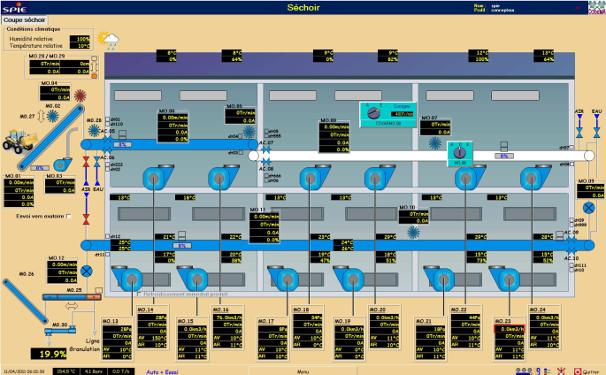
Example: humidity virtual sensor for Food & Bev
CONFIDENTIAL CUSTOMER CASE
Product to dry
Dried product
Problem statement: I want to dry “just enough” to be compliant with the food standards
However, there are only 2 ways to measure internal humidity of the output dried product:
- an Infrared (IR) sensor: surface humidity, not accurate for big products
- Lab measurements: too slow to use in a control loop
> the system cant be automated, I control it manually with a human operator
I have other data, though: various measurements in the system (Hr, T°, fan speeds…)
Virtual sensor : provide me with a software humidity sensor available in the PLC, accurate enough to control the system automatically. I accept to keep doing lab measurements to detect faults and improve the sensor over time

Slide 11
Concluding remarks, limits
Don’t reinvent the wheel
This domain has been applied a lot to images, videos, documents, the web, and time series
There is no « one-fits-all » algorithm available yet, but many with large coverage
There are many freely available libraries around, that work very good if the problem is well-posed.
Time series require special handling
Although machine learning and statistics algorithms are able to handle any data, additional tools such as adapted metrics, segmentation, cycle detection, and other signal processing algorithms are often needed when it comes to time series
Don’t trust excellent performance scores
After training, always validate the resulting model on representative never-seen-before data, using independent evaluation tools
Most pattern learning algorithm benefit from pattern discovery as a preprocessor, to discover macroscopic not-continuous states
e.g. profiling to discover types of days, or state of a machine

Slide 12
Appendix

Slide 13



Typical software architecture
Training data
Model
saving
What’s The Best That Can Happen?
Optimization
Model Database
In ???
Expert
User
Interface
What Will Happen Next? (Machinery Failure)
Predictive Modeling
What If Trends Continue?
Forecasting
Statistical Analysis
Why Is This Happening?
Notification Alerts
1
Query
Drilldown
What Action Is Needed?
Ad Hoc Reports
What Is The Cause of The Problem?
Standard Reports
How Many, How Often, Where?
What Happened?
3
Brick for Model
Creation / Update
2
Specific
Model Builder
Model
characteristics
(performance, etc.)
7
(+ possibly translation in e.g. PLC code)
5
New data
Applicative
User Interface, or control loop
What’s The Best That Can Happen?
Optimization
What Will Happen Next? (Machinery Failure)
Predictive Modeling
What If Trends Continue?
Forecasting
4
Statistical Analysis
Why Is This Happening?
Notification Alerts
Query
Drilldown
What Action Is Needed?
Ad Hoc Reports
What Is The Cause of The Problem?
Standard Reports
How Many, How Often, Where?
What Happened?
6
Brick for Model application
Prediction

Slide 14
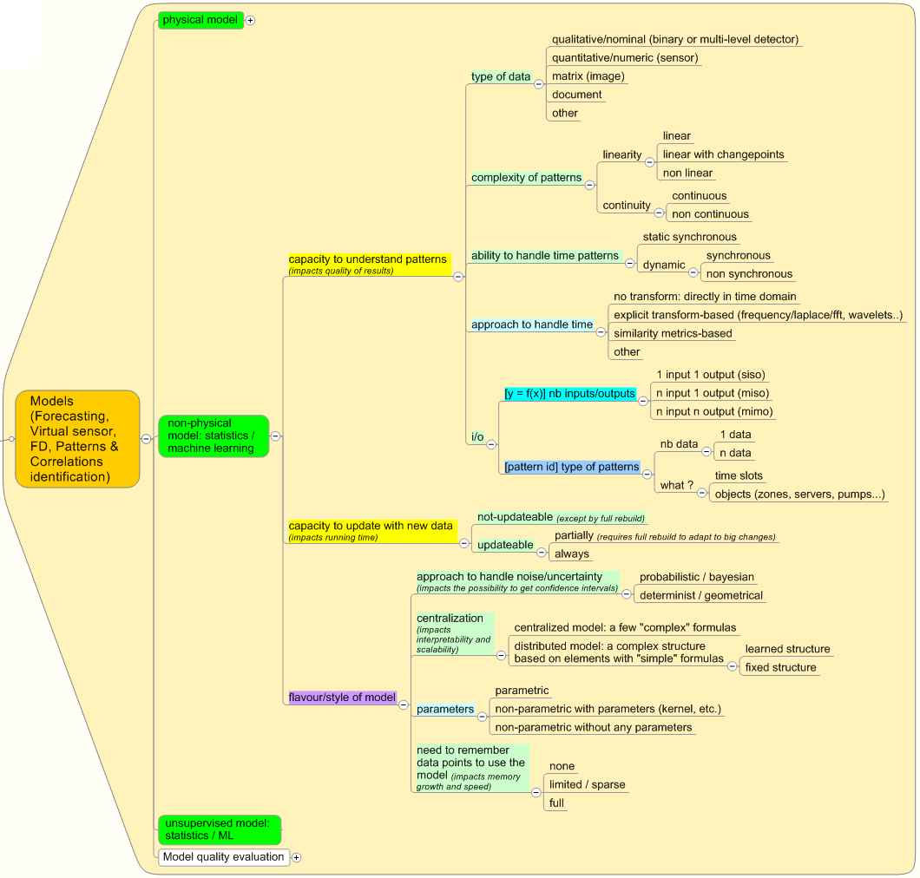
How to compare algorithms ?

Slide 15
References
Papers and books
A review of virtual sensing technology and application in building systems, Haorong Li a , Daihong Yu a & James E. Braun
Alppaydin, Machine Learning, 2010
Web & tools
http://en.wikipedia.org/wiki/Machine_learning
http://rapid-i.com/content/view/181/

Slide 16
Backup detailed slides for specific use cases

Slide 17
Available example data
01/01/2010 00:00 |  |  | 27/02/2013 19:33
0.8147 | 0.1576 | 0.6557 | 0.2760
0.9058 | 0.9706 | 0.0357 | 0.6797
0.1270 | 0.9572 | 0.8491 | 0.6551
0.9134 | 0.4854 | 0.9340 | 0.1626
0.6324 | 0.8003 | 0.6787 | 0.1190
0.0975 | 0.1419 | 0.7577 | 0.4984
0.2785 |  | 0.7431 | 0.9597
0.5469 | 0.9157 | 0.3922 | 0.3404
0.9575 | 0.7922 | 0.6555 | 0.5853
0.9649 | 0.9595 | 0.1712 | 0.2238
All other data
Target data ➔
0.8147 | 0.1576 | 0.6557 | 0.2760

Slide 18




More detailed context
Several data streams are available through some system
{data collection, integration, synchronization, aggregation, VEE…} done
01/01/2010 00:00
12.0
0.9058
0.1270
4
0.6324
0.0975
0.2785
0.5469
COOL
0.9649
0.8147
0.9058
0.1270
PRESENT
0.6324
0:32
0.2785
01/01/2010 01:00
12.0
0.0357
0.8491
2
0.6787
0.7577
0.7431
0.3922
HOT
0.1712
0.6557
0.0357
0.8491
PRESENT
0.6787
0:31
0.7431
01/01/2010 02:00
12.0
0.0357
0.8491
1
0.6787
0.7577
0.7431
0.3922
MEDIUM
0.1712
0.6557
0.0357
0.8491
ABSENT
0.6784
0:12
0.7431
01/01/2010 03:00
12.0
0.0357
0.8491
1
0.6787
0.7577
0.7431
0.3922
MEDIUM
0.1712
0.6557
0.0357
0.8491
PRESENT
0.6786
0:45
0.7431
01/01/2010 04:00
13.0
0.0357
0.8491
1
0.6787
0.7577
0.9431
0.3922
HOT
0.1812
0.6557
0.0357
0.8491
ABSENT
0.6787
08:32
0.7431
(uniform)
sampling
+1h
+1h
Notes:
Implementation methodology and examples. Specifying inputs and outputs (up to 3 slides)

Slide 19
More detailed context
Their content is of various types
01/01/2010 00:00
12.0
0.9058
0.1270
4
0.6324
0.0975
0.2785
0.5469
COOL
0.9649
0.8147
0.9058
0.1270
PRESENT
0.6324
0:32
0.2785
01/01/2010 01:00
12.0
0.0357
0.8491
2
0.6787
0.7577
0.7431
0.3922
HOT
0.1712
0.6557
0.0357
0.8491
PRESENT
0.6787
0:31
0.7431
01/01/2010 02:00
12.0
0.0357
0.8491
1
0.6787
0.7577
0.7431
0.3922
MEDIUM
0.1712
0.6557
0.0357
0.8491
ABSENT
0.6784
0:12
0.7431
01/01/2010 03:00
12.0
0.0357
0.8491
1
0.6787
0.7577
0.7431
0.3922
MEDIUM
0.1712
0.6557
0.0357
0.8491
PRESENT
0.6786
0:45
0.7431
01/01/2010 04:00
13.0
0.0357
0.8491
1
0.6787
0.7577
0.9431
0.3922
HOT
0.1812
0.6557
0.0357
0.8491
ABSENT
0.6787
08:32
0.7431
Numeric real
Numeric integer
Category (« poly-nominal »)
Boolean (« bi-nominal »)
Date, time

Slide 20
More detailed context
Missing points for example due to data collection system
There are real-life difficulties
01/01/2010 00:00
12.0
0.9058
0.1270
4
0.6324
0.0975
0.2785
0.5469
COOL
0.9649
0.8147
0.9058
0.1270
PRESENT
0.6324
0:32
0.2785
01/01/2010 01:00
12.0
0.0357
0.8491
2
0.6787
0.7577
0.7431
0.3922
0.1712
0.6557
0.0357
0.8491
0.6787
0:31
0.7431
01/01/2010 02:00
12.0
0.0357
0.8491
0.6787
0.7577
0.7431
0.3922
MEDIUM
0.1712
0.6557
0.0357
0.8491
0.6784
0:12
0.7431
01/01/2010 03:00
12.0
0.0357
0.8491
1
0.6787
0.7431
0.3922
MEDIUM
0.1712
0.6557
0.0357
0.8491
ABSENT
0.6786
0:45
0.7431
01/01/2010 04:00
13.0
0.0357
0.8491
1
0.6787
0.7577
0.9431
0.3922
HOT
0.1812
0.6557
0.0357
0.8491
0.6787
08:32
0.7431
Missing points due to very low sampling rates (e.g. manual entries, bills, analysis that is not done frequently/is costly)

Slide 21
Patterns and correlations identification
01/01/2010 00:00 |  |  | 27/02/2013 19:33
0.8147 | 0.1576 | 0.6557 | 0.2760
0.9058 | 0.9706 | 0.0357 | 0.6797
0.1270 | 0.9572 | 0.8491 | 0.6551
0.9134 | 0.4854 | 0.9340 | 0.1626
0.6324 | 0.8003 | 0.6787 | 0.1190
0.0975 | 0.1419 | 0.7577 | 0.4984
0.2785 |  | 0.7431 | 0.9597
0.5469 | 0.9157 | 0.3922 | 0.3404
0.9575 | 0.7922 | 0.6555 | 0.5853
0.9649 | 0.9595 | 0.1712 | 0.2238
Result:
only these 2 data streams are actually related to the target data
All other data available
Available historical data
0.8147 | 0.1576 | 0.6557 | 0.2760
0.9058 | 0.9706 | 0.0357 | 0.6797
0.1270 | 0.9572 | 0.8491 | 0.6551
0.9134 | 0.7922 | 0.9340 | 0.6551
0.6324 |  | 0.6787
0.0975 | 0.1419 | 0.7577 | 0.4984
0.2785 | 0.4218 | 0.7431 | 0.9597
Target data
Learn the patterns
(« create models »)

Slide 22
Forecasting
prediction horizon
prediction horizon
01/01/2010 00:00 |  |  | 27/02/2013 19:33
0.8147 | 0.1576 | 0.6557 | 0.2760
0.9058 | 0.9706 | 0.0357 | 0.6797
0.1270 | 0.9572 | 0.8491 | 0.6551
0.9134 | 0.4854 | 0.9340 | 0.1626
0.6324 | 0.8003 | 0.6787 | 0.1190
0.0975 | 0.1419 | 0.7577 | 0.4984
0.2785 |  | 0.7431 | 0.9597
0.5469 | 0.9157 | 0.3922 | 0.3404
0.9575 | 0.7922 | 0.6555 | 0.5853
0.9649 | 0.9595 | 0.1712 | 0.2238
27/02/2013 19:33 | 27/02/2013 19:53
0.6557 | 0.2760
0.0357 | 0.6797
0.8491 | 0.6551
0.9340 | 0.1626
0.6787 | 0.1190
0.7577 | 0.4984
0.7431 | 0.9597
0.3922 | 0.3404
0.6555 | 0.5853
0.1712 | 0.2238
27/02/2013 20:13 | 27/02/2013 20:43
0.6557 | 0.2760
0.0357 | 0.6797
0.8491 | 0.6551
0.9340 | 0.1626
0.6787 | 0.1190
0.7577 | 0.4984
0.7431 | 0.9597
0.3922 | 0.3404
0.6555 | 0.5853
0.1712 | 0.2238
Forecasting
Available historical data
Forecasting
Forecasting
Alert (FD)
Match ? If not
and/or
Update model
27/02/2013 19:33 | 27/02/2013 19:53
0.2760 | 0.7513
0.6797 | 0.2551
0.6551 | 0.5060
0.1626 | 0.6991
0.1190 | 0.8909
0.4984 | 0.9593
0.9597 | 0.5472
0.3404 | 0.1386
0.5853 | 0.1493
0.2238 | 0.2575
27/02/2013 19:33 | 27/02/2013 19:53
0.2760 | 0.7513
0.6797 | 0.2551
0.6551 | 0.5060
0.1626 | 0.6991
0.1190 | 0.8909
0.4984 | 0.9593
0.9597 | 0.5472
0.3404 | 0.1386
0.5853 | 0.1493
0.2238 | 0.2575
Learn the patterns
(« create models »)
New collected data
New collected data

Slide 23
Learning-based virtual sensor
01/01/2010 00:00 |  |  | 27/02/2013 19:33
0.8147 | 0.1576 | 0.6557 | 0.2760
0.9058 | 0.9706 | 0.0357 | 0.6797
0.1270 | 0.9572 | 0.8491 | 0.6551
0.9134 | 0.4854 | 0.9340 | 0.1626
0.6324 | 0.8003 | 0.6787 | 0.1190
0.0975 | 0.1419 | 0.7577 | 0.4984
0.2785 |  | 0.7431 | 0.9597
0.5469 | 0.9157 | 0.3922 | 0.3404
0.9575 | 0.7922 | 0.6555 | 0.5853
0.9649 | 0.9595 | 0.1712 | 0.2238
27/02/2013 19:33 | 27/02/2013 19:53
0.2760 | 0.7513
0.6797 | 0.2551
0.6551 | 0.5060
0.1626 | 0.6991
0.1190 | 0.8909
0.4984 | 0.9593
0.9597 | 0.5472
0.3404 | 0.1386
0.5853 | 0.1493
0.2238 | 0.2575
27/02/2013 19:33 | 27/02/2013 19:53
0.2760 | 0.7513
0.6797 | 0.2551
0.6551 | 0.5060
0.1626 | 0.6991
0.1190 | 0.8909
0.4984 | 0.9593
0.9597 | 0.5472
0.3404 | 0.1386
0.5853 | 0.1493
0.2238 | 0.2575
New collected data
New collected data
Data always available
Available historical data
0.8147 | 0.1576 | 0.6557 | 0.2760
0.9058 | 0.9706 | 0.0357 | 0.6797
0.1270 | 0.9572 | 0.8491 | 0.6551
0.9134 | 0.7922 | 0.9340 | 0.6551
0.6324 |  | 0.6787
0.0975 | 0.1419 | 0.7577 | 0.4984
0.2785 | 0.4218 | 0.7431 | 0.9597
0.6797 | 0.2551
0.6551 | 0.5060
0.1626 | 0.6991
0.1190 | 0.8909
0.4984 | 0.9593
0.9597 | 0.5472
0.3404 | 0.1386
0.6797 | 0.2551
0.6551 | 0.5060
0.1626 | 0.6991
0.1190 | 0.8909
0.4984 | 0.9593
0.9597 | 0.5472
0.3404 | 0.1386
Data that we want to replace with virtual sensors
Learning-based virtual sensors
Learning-based virtual sensors
Alert (FD)
Match ? If not
and/or
Update model
Optionally collected data
(real sensor, or manual/lab sensing)
0.6797
0.6551
0.1626
0.1190
0.4984
0.9597
0.3404
Learn the patterns
(« create models »)

Slide 24
Learning-based virtual sensor
01/01/2010 00:00 |  |  | 27/02/2013 19:33
0.8147 | 0.1576 | 0.6557 | 0.2760
0.9058 | 0.9706 | 0.0357 | 0.6797
0.1270 | 0.9572 | 0.8491 | 0.6551
0.9134 | 0.4854 | 0.9340 | 0.1626
0.6324 | 0.8003 | 0.6787 | 0.1190
0.0975 | 0.1419 | 0.7577 | 0.4984
0.2785 |  | 0.7431 | 0.9597
0.5469 | 0.9157 | 0.3922 | 0.3404
0.9575 | 0.7922 | 0.6555 | 0.5853
0.9649 | 0.9595 | 0.1712 | 0.2238
27/02/2013 19:33 | 27/02/2013 19:53
0.2760 | 0.7513
0.6797 | 0.2551
0.6551 | 0.5060
0.1626 | 0.6991
0.1190 | 0.8909
0.4984 | 0.9593
0.9597 | 0.5472
0.3404 | 0.1386
0.5853 | 0.1493
0.2238 | 0.2575
27/02/2013 19:33 | 27/02/2013 19:53
0.2760 | 0.7513
0.6797 | 0.2551
0.6551 | 0.5060
0.1626 | 0.6991
0.1190 | 0.8909
0.4984 | 0.9593
0.9597 | 0.5472
0.3404 | 0.1386
0.5853 | 0.1493
0.2238 | 0.2575
New collected data
New collected data
Data always available
Available historical data
0.8147 | 0.1576 | 0.6557 | 0.2760
0.9058 | 0.9706 | 0.0357 | 0.6797
0.1270 | 0.9572 | 0.8491 | 0.6551
0.9134 | 0.7922 | 0.9340 | 0.6551
0.6324 |  | 0.6787
0.0975 | 0.1419 | 0.7577 | 0.4984
0.2785 | 0.4218 | 0.7431 | 0.9597
0.6797 | 0.2551
0.6551 | 0.5060
0.1626 | 0.6991
0.1190 | 0.8909
0.4984 | 0.9593
0.9597 | 0.5472
0.3404 | 0.1386
0.6797 | 0.2551
0.6551 | 0.5060
0.1626 | 0.6991
0.1190 | 0.8909
0.4984 | 0.9593
0.9597 | 0.5472
0.3404 | 0.1386
Data that we want to replace with virtual sensors
Learning-based virtual sensors
Learning-based virtual sensors
Note: as soon as we have a method to forecast the required data , we can also provide a forecast for the virtual sensor data. For example if the virtual sensor only depends on production orders + external temperature.

Slide 25
Learning-based virtual sensor
01/01/2010 00:00 |  |  | 27/02/2013 19:33
0.8147 | 0.1576 | 0.6557 | 0.2760
0.9058 | 0.9706 | 0.0357 | 0.6797
0.1270 | 0.9572 | 0.8491 | 0.6551
0.9134 | 0.4854 | 0.9340 | 0.1626
0.6324 | 0.8003 | 0.6787 | 0.1190
0.0975 | 0.1419 | 0.7577 | 0.4984
0.2785 |  | 0.7431 | 0.9597
0.5469 | 0.9157 | 0.3922 | 0.3404
0.9575 | 0.7922 | 0.6555 | 0.5853
0.9649 | 0.9595 | 0.1712 | 0.2238
27/02/2013 19:33 | 27/02/2013 19:53
0.2760 | 0.7513
0.6797 | 0.2551
0.6551 | 0.5060
0.1626 | 0.6991
0.1190 | 0.8909
0.4984 | 0.9593
0.9597 | 0.5472
0.3404 | 0.1386
0.5853 | 0.1493
0.2238 | 0.2575
27/02/2013 19:33 | 27/02/2013 19:53
0.2760 | 0.7513
0.6797 | 0.2551
0.6551 | 0.5060
0.1626 | 0.6991
0.1190 | 0.8909
0.4984 | 0.9593
0.9597 | 0.5472
0.3404 | 0.1386
0.5853 | 0.1493
0.2238 | 0.2575
New collected data
New collected data
Data always available
Available historical data
0.8147 | 0.1576 | 0.6557 | 0.2760
0.9058 | 0.9706 | 0.0357 | 0.6797
0.1270 | 0.9572 | 0.8491 | 0.6551
0.9134 | 0.7922 | 0.9340 | 0.6551
0.6324 |  | 0.6787
0.0975 | 0.1419 | 0.7577 | 0.4984
0.2785 | 0.4218 | 0.7431 | 0.9597
0.6797 | 0.2551
0.6551 | 0.5060
0.1626 | 0.6991
0.1190 | 0.8909
0.4984 | 0.9593
0.9597 | 0.5472
0.3404 | 0.1386
0.6797 | 0.2551
0.6551 | 0.5060
0.1626 | 0.6991
0.1190 | 0.8909
0.4984 | 0.9593
0.9597 | 0.5472
0.3404 | 0.1386
Data that we want to replace with virtual sensors
Learning-based virtual sensors
Learning-based virtual sensors
Note 2:
- if the target data is nominal, we call that « classification ».
- If the target data is numeric we call that « regression »

Slide 26
Regression modeling
Exact same thing than virtual sensor, but
Requirements are different
The pattern should be simple so that it can be used in legal performance contracts > linear or piecewise linear patterns preferred
For the same reason, static models are often preferred for regression modeling. These models are independent on time or sequence of events; therefore are less accurate to handle a system with dynamics/latencies, but are easier to use when it comes to normalization/benchmarking (see next slide)
Regression modeling in Schneider Electric’s wording strongly focuses on energy in the buildings market, whereas virtual sensors are mentioned not only for energy but also for various process data in the industrial market
Model quality wording and metrics are also not the same: regression models use wording from the statistics field (R², Correlation, significance test…) whereas industrial customer whant « sensor-like » performance (error rate, precision interval…)

Slide 27
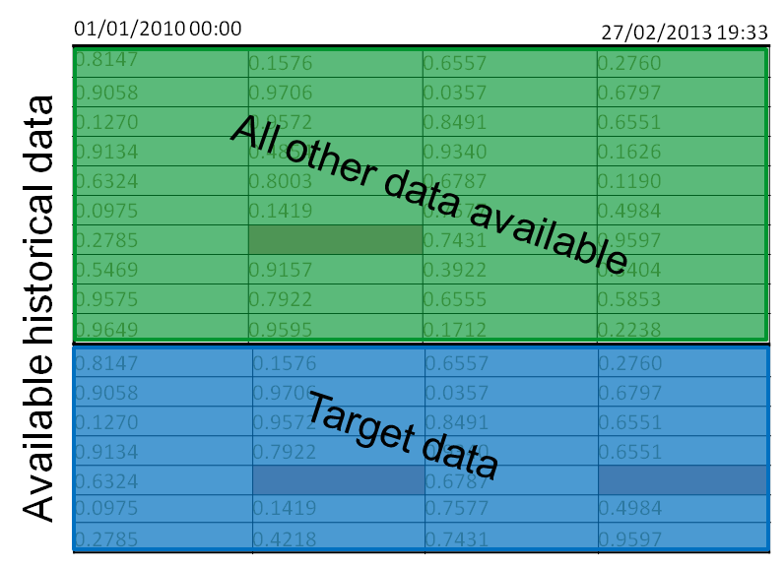
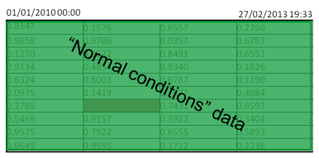
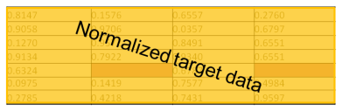
Performance evaluation and benchmarking
System A, under conditions a
System B, under conditions b
E
T°ext
Learn the patterns
(« create model A »)
Learn the patterns
(« create model B »)
(1) Compare the models
or
(2) Compare target data under normal conditions
« apply model A »
« apply model B »
%
« what would be the output if the system was placed under normalized conditions (e.g. normalized external weather) ? »

Slide 28
Performance evaluation and benchmarking
Cooling more performant
Heating more performant
Less base idle power
Cooling more performant
Heating as performant
Same base idle power
Additional use cases appear
Normalization is a very common use case in the performance contracting application: « what would be the output if the system was placed under normalized conditions (e.g. normalized external weather) ? »

Slide 29
Condition monitoring and Diagnosis
Fault / abnormal condition detection
Some level of fault detection can be reached by comparing the output of the model and the actual data, and fixing a “safety boundary” (e.g. ±5%)
See « forecasting » and « virtual sensor »
Diagnosis
Diagnosis is more than abnormal condition detection. It requires expert knowledge about the system being monitored.
That knowledge can be either
learned from examples of faults annotated by experts (like a virtual sensor of diagnosis status)
or explicitly described (expert rules)

Slide 30
Implementation : a common methodology Getting training data
How to get representative training data in the first place ?
Observe the system: retrieve historical data
Excite the system with commands.
In control theory this is called « open loop identification » and focuses mostly in providing step inputs to see a lot of harmonics
In statistics and machine learning domain there is no particular advice other than « be representative »
If the system is already controlled when learning this is called “closed loop identification”.

Slide 31
Implementation : a common methodology Handling training data
A vast majority of pattern learning algorithms work the exact same way. The available example data is split into two:
Learning/training phase: find the “best” model
The meaning of « best » is tailored to application (error metrics): best fit, best generalization, best control…
But some models are so powerful that they can always reach “0 error” (overfitting)
Therefore special validation procedures help to ensure that these models stay simple and have good generalization error (cross-validation, bootstrapping, jackknife, bagging)
Testing phase: evaluate the true performance of the model on unseen data
This is the only way to assess the “generalization error” !
Note: for algorithms that only spot « static » patterns, (1) and (2) should be randomly chosen in the data, typically 90/10% . For algorithms that can handle « dynamic » patterns, special versions of (1) and (2) are to be used.
(1)
(2)

Slide 32
Implementation: a common methodology Handling new live data
Most models are trained as explained in the previous slides. This is named offline learning because it is not connected to live data.
Online learning means that we learn on live data.
In a vast majority of cases an initial model is learned « offline »
When live data comes in, the model is used to predict a value.
Sometimes we have the true value afterwards: if it is different it is either a fault or an error of the algorithm.
If we decide that it is not a fault, we can improve the algorithm by updating the model:
Some algorithms are able to update the model using the new example (faster)
For all other algorithms, it is always possible to fully re-learn (like offline)
Algorithms able to update faster than the speed of live data are sometimes called « streaming ». The others require to group several new data together in order not to loose to much time (« batch »)
Initial model learned offline
estimation/prediction
actual value
12
15
update model
difference ?
FAULT DETECTED

Slide 33
How does it work ? « Online learning »
batch or stream
Apply model
New data
System
actual value (if available later)
prediction
Initial model learned offline
15
12
difference ?
AND/OR
FAULT DETECTED
Update model
batch or stream
Apply model
New data
System
Initial model learned offline
prediction
actual value (if available later)
12
15
difference ?
AND/OR
Update model
FAULT DETECTED

Slide 34
Implementation: a common methodology Handling macroscopic system states
A vast majority of algorithms rely on strong hypothesis. The system:
behaves in a continuous fashion,
always behaves according to the same pattern: invariance
However most real-world systems are controlled by humans or computers, and have macro states
A building is open / closed
Workers have shifts
A process machine has state
etc.
Pb: the data describing these « internal states » is not always explicit
E.g. the notion of « holidays » is dependent upon the country
For this reason it is often a good thing to empower pattern learning with a pattern discovery algorithm beforehand,
it will be able to « spot » these states and create data representing it

